Slide 1
A Practical Start with React
SHOULD YOU REACT?

Slide 2

Module Overview
What we're building
What you should know Why React is great Working with components
React compared to Angular and Vue

Slide 3
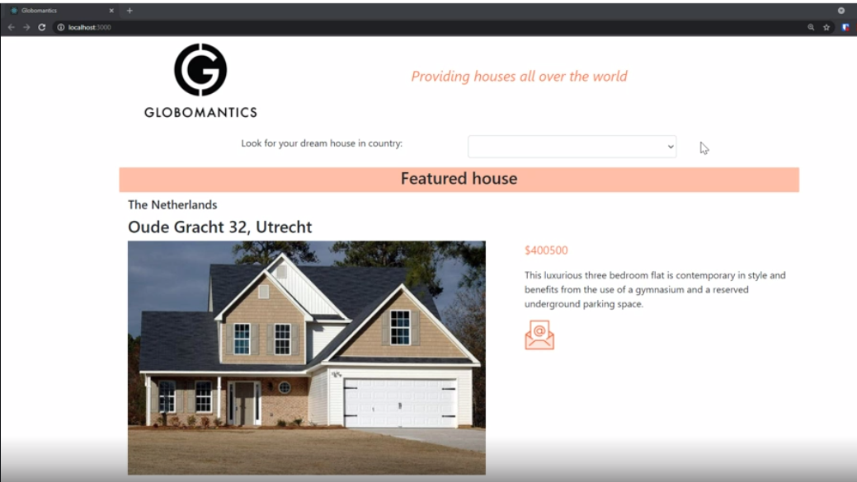

Slide 4
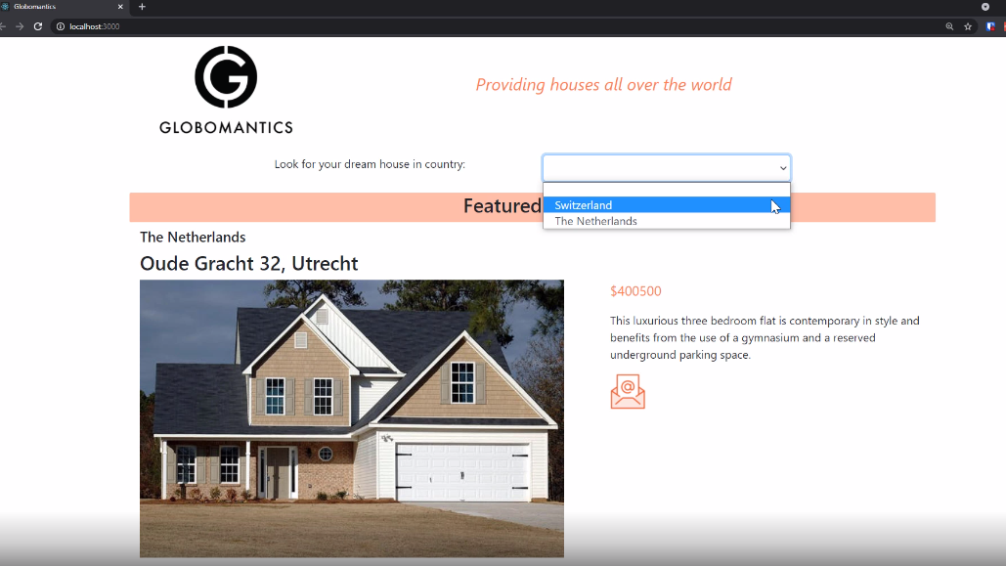

Slide 5
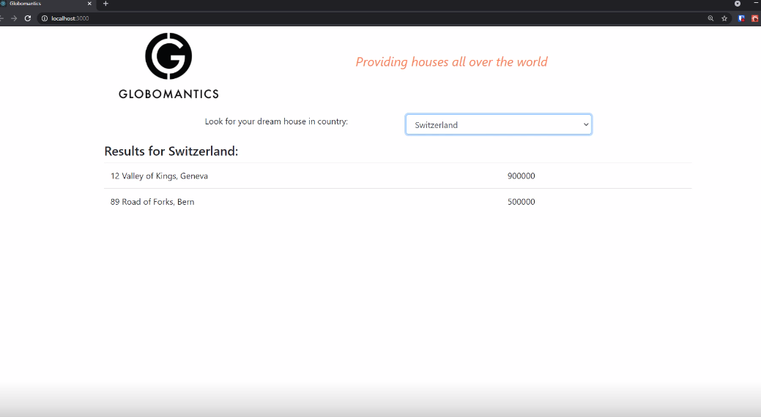

Slide 6
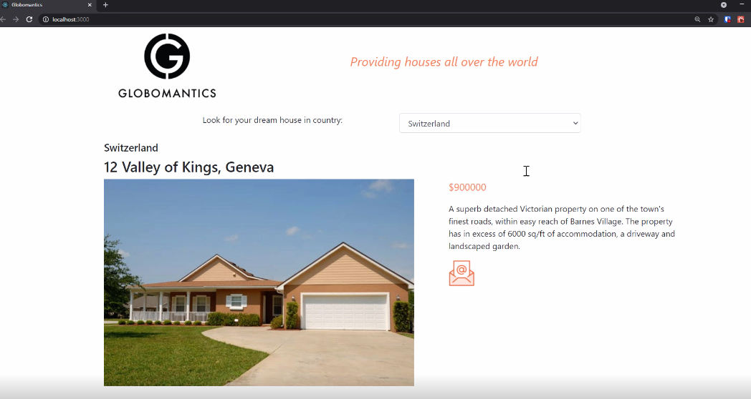

Slide 8

JavaScript (ES 2017/ES8)
Bootstrap 4
Prerequisites

Slide 9


Slide 10
Element Tree
React.createElement( "div",
{ className: "split" }, React.createElement("input"),
React.createElement( "p",
null,
"Sunday 4:00 pm")
);
<div class="split">
<input />
<p>Sunday 4:00 pm</p>
</div>

Slide 11
What is displayed in the browser is a reflection of the state of the application.

Slide 12
Tree Reconciliation
React.createElement( "div",
{ className: "split" }, React.createElement("input"),
React.createElement( "p",
null,
"Sunday 4:01 pm")
);
React.createElement( "div",
{ className: "split" }, React.createElement("input"),
React.createElement( "p",
null,
"Sunday 4:00 pm")
);

Slide 13
JSX
React.createElement( "div",
{ className: "split" }, React.createElement("input"),
React.createElement( "p",
null,
"Sunday 4:01 pm")
);
<div className="split">
<input/>
<p>
Sunday 4:01 pm
</p>
</div>

Slide 14
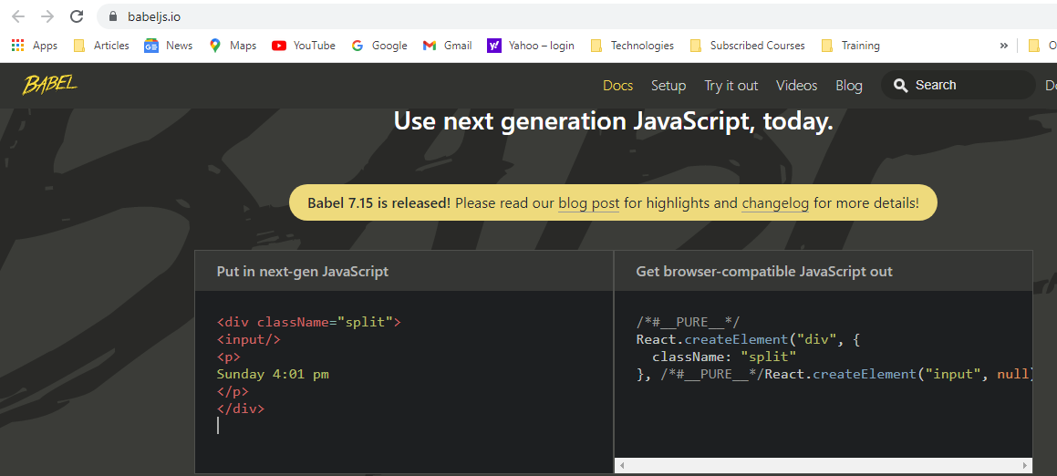

Slide 15
The React Workflow
React.createElement( "div",
{ className: "split" }, React.createElement("input"), React.createElement(
"p",
null,
"Sunday 4:01 pm")
);
<div className="split">
<input/>
<p>
<div class="split">
<input type="text"/>
<p>
Sunday 4:01 pm
</p>
</div>
React DOM
Babel
Sunday 4:01 pm
</p>
</div>

Slide 16
React is a javascript library to create and compose components

Slide 17
Component
props
State
Render()
<Component prop="value"/>

Slide 18
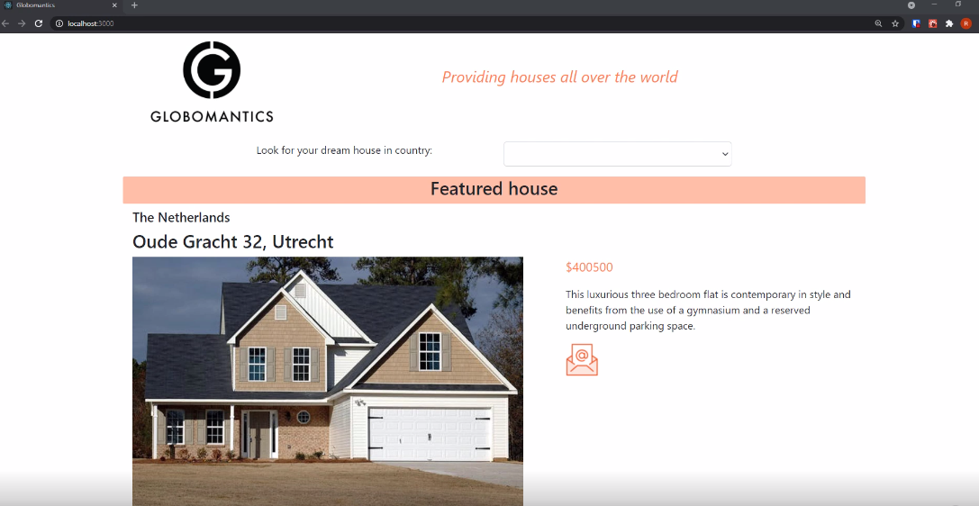

Slide 19
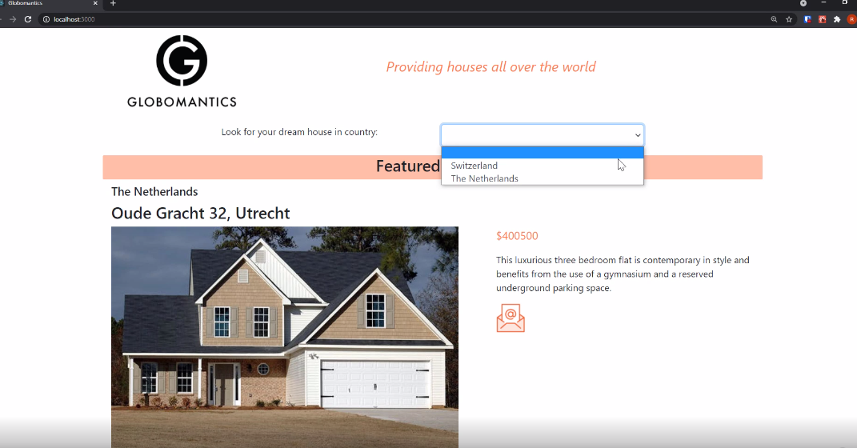

Slide 20
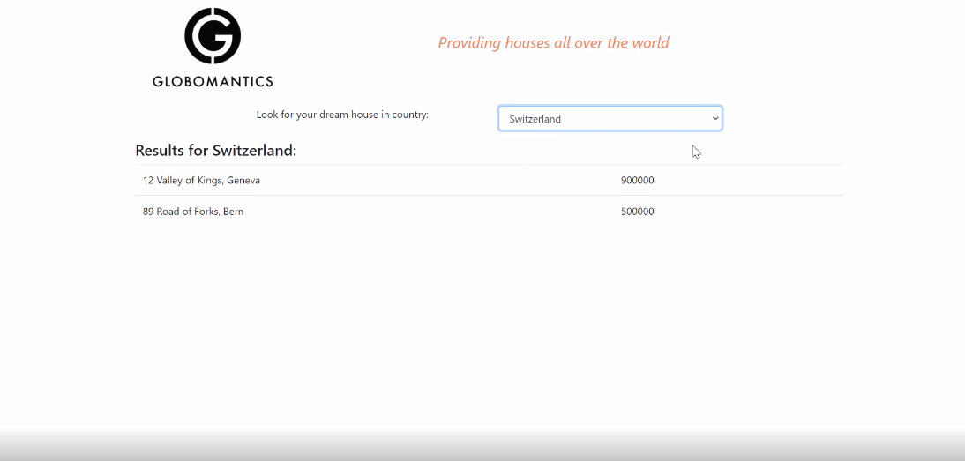

Slide 21
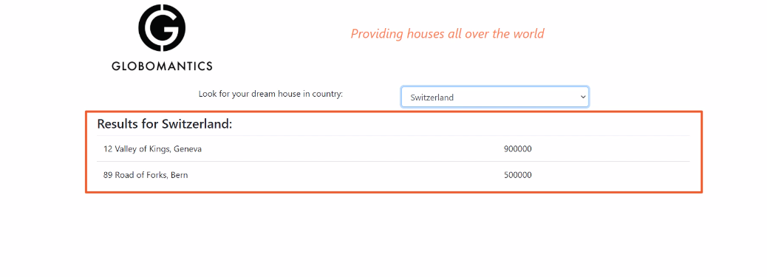

Slide 22
Composition
Header
FeaturedHouse
SearchResults
HouseDetail
ResultRow

Slide 23



Comparing React to Others
These are all excellent products

Slide 24
Comparing React to Others
React | Angular | Vue
Components | Components | Components
Library | Framework | Library
Facebook | Google | Community
MIT | MIT | MIT
1 way data-binding | 2 way data-binding | 1 way data-binding
UI in JavaScript | UI in HTML | UI in HTML

Slide 25
Smart UI updates
Tree reconciliation JSX
Components Alternatives
Summary

